Slide 1
Integration of cloud manufacturing and cyber-physical systems in the era of industry 4.0 -
An Open Platform Communication - Unified Architecture (OPC UA) approach
Authors: Tang Ji, Xun Xu
Journal: Robotics and Computer-Integrated Manufacturing
Year: 2025
IF: 11.2
Name: Seshapriyan T
Regr No.: 127033016
M.Tech. CSE

Slide 2
Presentation Outline
Background and motivation
Industry 4.0 and Cyber - Physical Systems (CPS)
Overview of Cloud Manufacturing
Integration challenges in smart manufacturing
Role of OPC UA as a communication standard
Proposed hybrid CPS - Cloud architecture
Advantages and limitations of the approach
Conclusion and future research directions

Slide 3
Problem Statement
To address the communication issues, the authors proposed an OPC UA- based hybrid architecture that integrates Cloud Manufacturing and Cyber -Physical Systems.
The proposed framework enables secure, interoperable, and real-time communication across physical machines, cloud services, and enterprise applications.

Slide 4
Introduction
Industry 4.0 aims at smart and connected manufacturing
Traditional manufacturing systems are isolated
Cloud Manufacturing enables service-oriented production
Cyber-Physical Systems (CPS) connect physical and digital worlds
Supports real-time monitoring and optimisation
Integration of Cloud Manufacturing and CPS is still challenging
Communication standards play a critical role

Slide 5
Literature Survey
S. No. | Title (with Year) | Authors | Journal | Inference
1. | Digital Twin Driven Smart Manufacturing - 2022 | Fei Tao, et al. | IEEE Transactions on Industrial Informatics | Proposed digital twin framework for real-time monitoring and optimisation of manufacturing systems.
2. | Cloud Manufacturing Service Platform - 2021 | Zhang, et al. | IEEE Transactions on Industrial Informatics | Developed a service-oriented cloud manufacturing platform for efficient resource sharing and scheduling
3. | Digital Twin and Big Data Towards Smart Manufacturing and Industry 4.0 - 2019 | Qinglin Qi, Han So, et al. | IEEE Transactions | Integrated digital twin, big data, and CPS for intelligent manufacturing systems

Slide 6
Literature Survey (contd.)
S. No. | Title (with Year) | Authors | Journal | Inference
4. | Simulation in Manufacturing: Review and Challenges - 2019 | Dimitris Mourtzis, et al. | Procedia CIRP | Discussed Industry 4.0 challenges including real-time data integration and decision-making
5. | Cyber-Physical Systems for Predictive Manufacturing Systems - 2018 | Jay Lee, et al. | IEEE Transactions on Manufacturing Letters | Introduced CPS for predictive maintenance and real-time decision-making in manufacturing

Slide 7
Background of Manufacturing Systems
Traditional manufacturing is centralized
High capital investment required
Limited flexibility and scalability
Poor interoperability between machines
Difficult integration with IT systems
Need for modern manufacturing paradigms

Slide 8
Industry 4.0 Overview
Fourth Industrial Revolution
Integration of cyber and physical systems
Use of IoT, cloud, AI, and automation
Smart factories and smart products
Real-time data-driven decisions
Enables decentralised decision-making
Improves production flexibility
Vertical and horizontal integration

Slide 9
Cyber-Physical Systems (CPS)
Tight coupling of physical and digital systems
Sensors and actuators monitor machines
Continuous feedback loops
Real-time data acquisition
Enables adaptive control
Improves automation and intelligence
Supports adaptive and self-optimising systems

Slide 10
Cloud Computing in Manufacturing
On-demand access to computing resources
Scalable storage and processing
Internet-based service delivery
Pay-as-you-use model
Reduced local infrastructure
Enables global accessibility

Slide 11
Cloud Manufacturing Concept
Manufacturing resources offered as services
Supports on-demand manufacturing
Virtualisation of machines and tools
Supports distributed manufacturing
Enables resource sharing
Improves flexibility and utilisation
Integrates IT and manufacturing

Slide 12
Integration Challenges
Protocol mismatch across systems
Different systems use incompatible standards
Latency in cloud communication
Affects real-time decision-making
Security and privacy concerns
Legacy system integration
Lack of standardisation

Slide 13
Role of Communication Protocols
Enable data flow across layers
Supports bidirectional communication
Connect shop floor to cloud
Bridges gap between physical and digital systems
Support real-time monitoring
Ensure interoperability
Enables integration of heterogeneous devices
Maintain data integrity

Slide 14
OPC UA Overview
Platform and vendor independent
Secure by design
Supports encryption and authentication
Supports complex data models
Scalable and extensible
Cloud and enterprise friendly
Works across multiple industrial layers

Slide 15
Why OPC UA for CMfg
Standardised communication protocol
Eliminates vendor-specific limitations
Solves interoperability issues
Supports real-time monitoring
Integrates legacy and modern systems
Acts as middleware for protocol conversion
Works across multiple layers
Suitable for industrial environments

Slide 16
Proposed Hybrid Architecture
Integrates Cloud Manufacturing and CPS
Uses OPC UA as communication backbone
Enables seamless data exchange across layers
Combines physical, digital, and cloud layers
Supports real-time data flow
Enables low-latency communication via CPS
Scalable and flexible design
Industry-oriented architecture

Slide 17
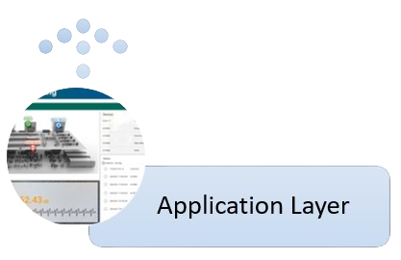
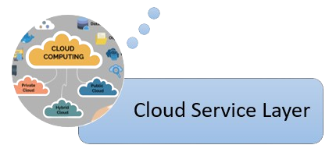
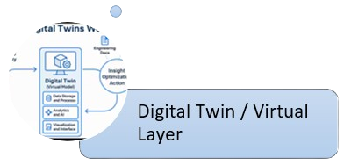
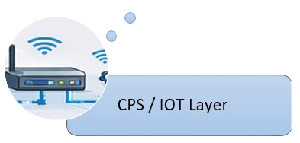
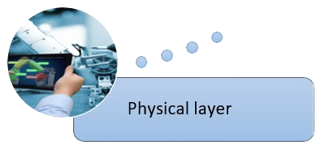
Architecture
Physical manufacturing resource layer
CPS / IoT sensing layer
Digital Twin / virtual service layer
Cloud service layer
Application layer

Slide 18
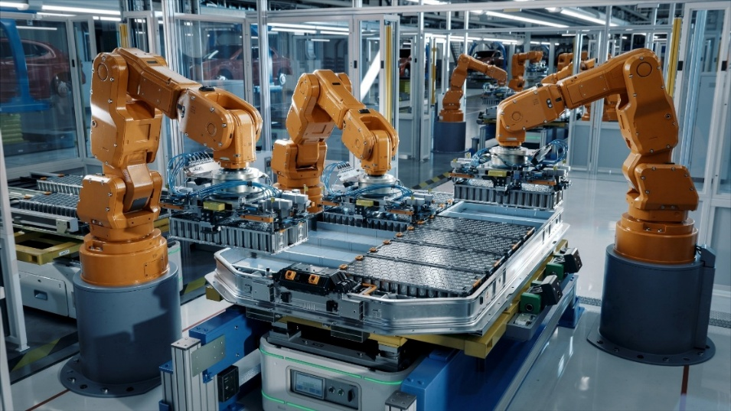
Physical Layer
Machines, Computer Numerical Control (CNC) systems
Sensors and actuators
Includes CPS
Performs manufacturing operations
Generates real-time data
Supports automation

Slide 19
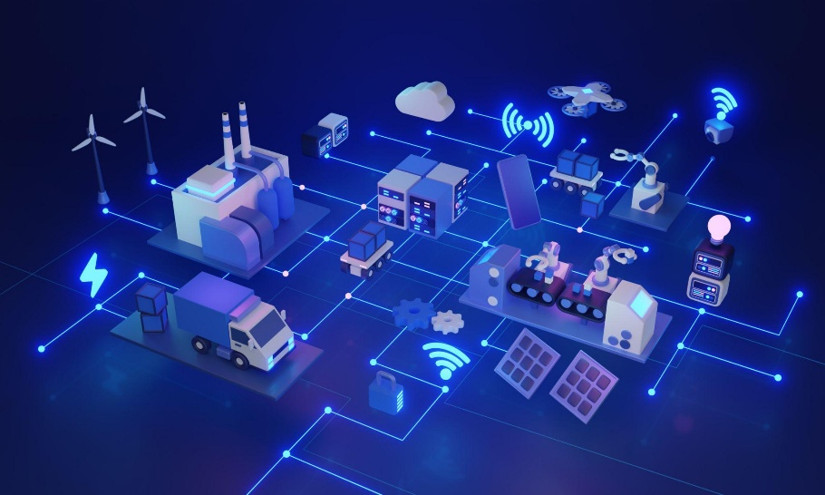
Virtual/Digital Twin Layer
Virtual representation of machines
Real-time synchronisation
Mirrors physical system behaviour
Edge devices for low latency
Supports simulation
Enables testing before real execution
Enables predictive maintenance
Improves efficiency
Optimises production and reduces downtime

Slide 20
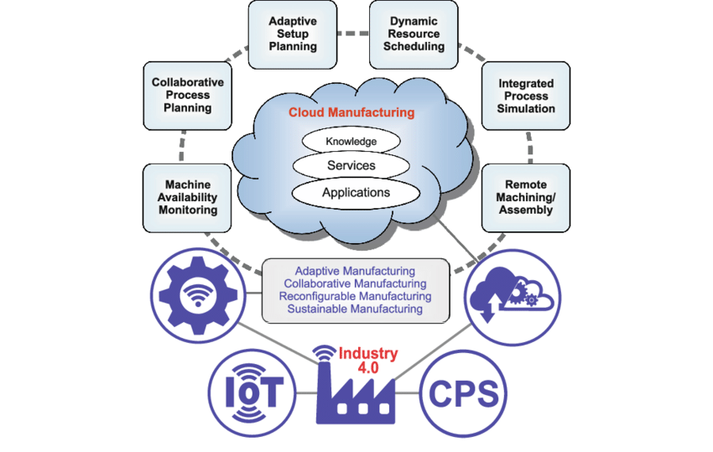
Cloud Service Layer
Data storage and processing
Handles large-scale industrial data
Analytics and optimisation
Private and public cloud usage
AI and big data integration
Enables predictive analytics
Scalable infrastructure
Uses public and private cloud for flexibility and security

Slide 21
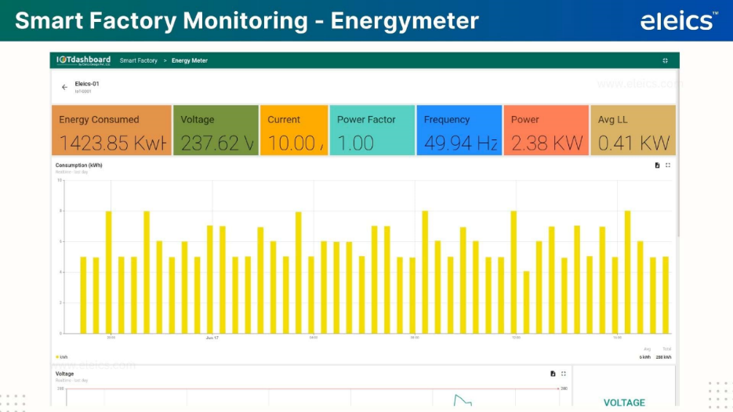
Application Layer
Monitoring dashboards
Decision support tools
Uses analytics for optimisation
Resource management
Visualization of data
Provides user interface for monitoring and control

Slide 22
Working Principle – Block diagram
Layer - 5
Application Layer
OPC UA
Protocol
ERP
MES
SCADA
Monitoring Dashboard
Decision Support
Analytics & Decision
Layer - 4
Cloud Service Layer
Public/Private Cloud
Scalable Storage & Processing
AI Usage
Predictive Analysis
Resource Scheduling
Processed Data
Layer - 3
Digital Twin Layer
Virtual Machine Models
Real-Time Synchronization
Simulation Environments
Predictive Maintenance
Sensor Streams
Layer - 2
CPS Layer
IoT Sensors
Real-time Data Acquisition
Embedded Controllers
Continuous Feedback loops
Physical Signals
Layer - 1
Physical Layer
Assembly Line
CNC Machines
Machining Tools

Slide 23
Advantages of Proposed Approach
Improved interoperability
Enables seamless system integration
Secure communication
Real-time monitoring
Improves operational efficiency
Scalable architecture
Vendor-neutral integration
Enhances resource utilisation

Slide 24
Challenges and limitations
Complexity of integration
Multi-layer integration increases system complexity
Network latency issues
Legacy system compatibility
Security management
Requires advanced security mechanisms
Skill requirements
High dependency on network reliability

Slide 25
Future Work
Real industrial implementation
Performance benchmarking
Latency optimisation
Advanced AI integration
Enables intelligent decision-making
Security enhancement
Large-scale deployment studies

Slide 26
Conclusion
Integration of CPS and cloud is essential
OPC UA enables seamless communication
Hybrid architecture improves efficiency
Supports real-time manufacturing
Enhances scalability and flexibility
Suitable for Industry 4.0
Strong potential for adoption

